Slide 1
COMP 790 The Internet of Things
Date: 8/18
Shahriar Nirjon
nirjon@cs.unc.edu
SN #258

Slide 2
Agenda
Logistics/Course Structure
Introduction to the IoT
Paper Presentation Guidelines

Slide 3
#1. Logistics

Slide 4
Logistics
T and Th (9:30 am – 10:45 am)
No Prerequisites
No Text Books (mainly papers)
Office Hours: after class (by appointment)
Course Webpage: https://iota.web.unc.edu/
Makeup Classes (if needed)

Slide 5
Course Structure
Class Participation (15%)
Paper Synopsis (10%)
Paper Presentation (25%)
Mid-term Project Report (25%)
Final Project Report (25%)

Slide 6
1. Class Participation
Come to the class
Bring questions about the paper
Participate in discussions
No playing with cellphones, laptops, or anything else that distract you and the class

Slide 7
2. Synopsis
What is it?
Bring it daily (no need for the presenter)
Preferred Style:
Use a word processor
1 pg. (max)
Bullet-list of key insights (e.g. claim, approach, evaluation, your comments)

Slide 8
3. Presentation
Email the slides for an early feedback
~20 min followed by discussion
Lead the discussion and Q/A (in and after)
Tips:
Not just the facts – present your own view
Find flaws, be a critique
Make it interesting (add surprises)
Follow the guidelines (discussed later)

Slide 9
4. Mid-Term Project Report
Individual Report
Decide the topic by next week
Short 4 page write-up (conference format)
You do not have to implement the idea for a 4 page mid-term report
Due last class before midterm
Follow guideline (discussed next class)

Slide 10
5. Final Project Report
Two options:
Complete the mid term project (with full evaluation, 6-8 pages, due last week),
or
A different idea (think of it as another mid-term report on a new topic, due last week)

Slide 11
Paper Lottery
First N paper presenters
Check the course page for updated schedule and paper list (tonight)

Slide 12
#2. Introduction to the IoT

Slide 13
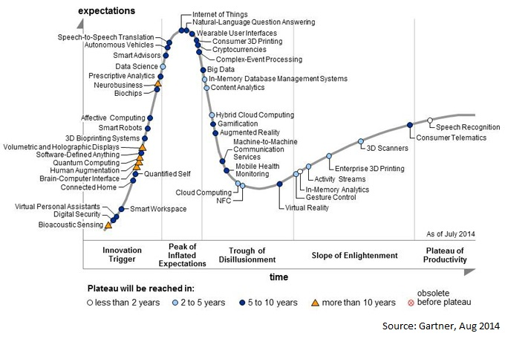
The IoT Hype (2015)

Slide 14
Hype vs. Fact
2011: NFC Payment, Internet TV
2012: BYOD, 3D Printing
2013: Wearable UI, Gamification, Consumer 3D printing
2014: NLP, IoT

Slide 15
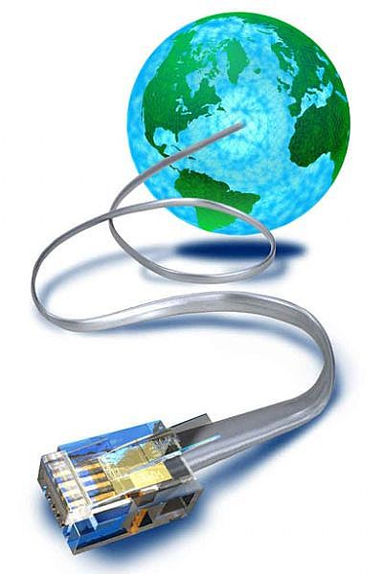
The IoT Concept

Slide 16
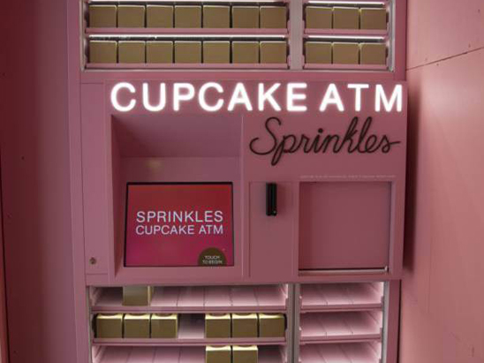
Example 1
Cupcake Conveyor —
Yes, an actual cupcake ATM that Davis called a “confectionery 3D printer.” There are Sprinkles’ cupcakes ATMs in several cities in the United States, including Beverly Hills, Chicago, New York and Atlanta.
http://www.sprinkles.com/cupcake-atm

Slide 17
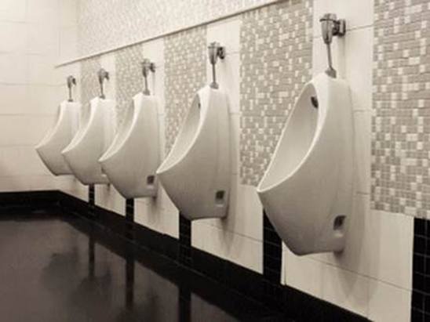
Example 2
Smart Loos —
Found in Heathrow’s Terminal 2, these smart loos have embedded sensors that track people’s movement and bathroom flow, and can alert maintenance crews if there’s a problem
London’s Heathrow Airport

Slide 18
Let’s think of the similarities

Slide 19
Driving Forces of IoT
Sensor Technology – Tiny, Cheap, Variety
Cheap Miniature Computers
Low Power Connectivity
Capable Mobile Devices
Power of the Cloud

Slide 20
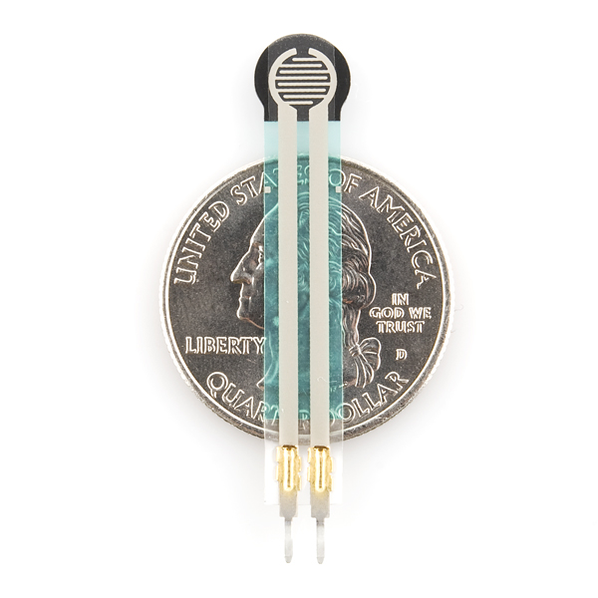
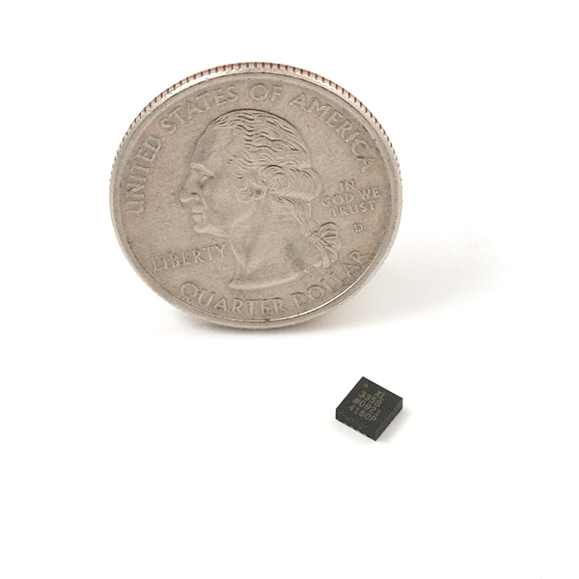
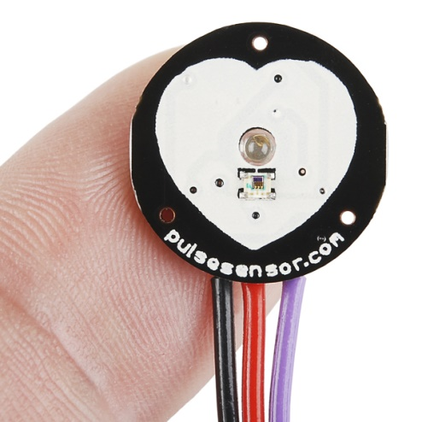
1. Sensor Technology
Accelerometer
(4mm diameter)
Force Sensor
(0.1N – 10N)
Pulse Sensor
$25
https://www.sparkfun.com/
https://www.adafruit.com/

Slide 21
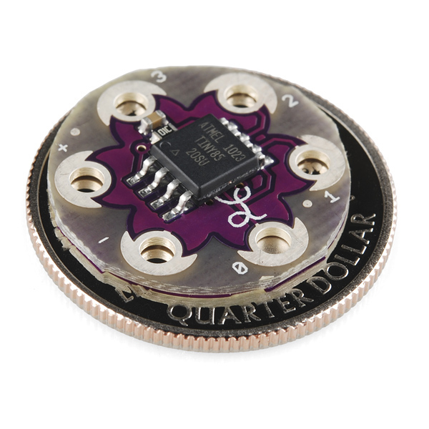
2. Cheap Mini Computers
Key Parameters
Flash: 8 Kbytes
Pin Count: 8
Max. Operating Freq: 20 MHz
CPU: 8-bit AVR
Max I/O Pins: 6
Ext Interrupts: 6
SPI: 1
I2C: 1
Lily Tiny
Guess the Price?
http://www.atmel.com/devices/ATTINY85.aspx?tab=parameters

Slide 22
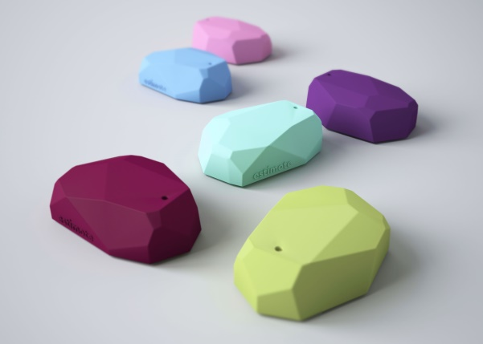
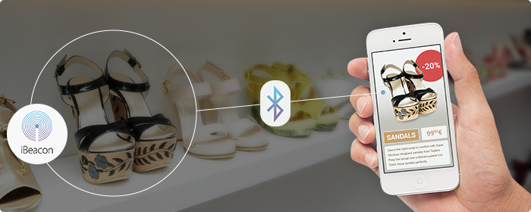
3. Low Power Connectivity
Bluetooth Smart (4.0)
(Up to 2 years with a single
Coin-cell battery)

Slide 23
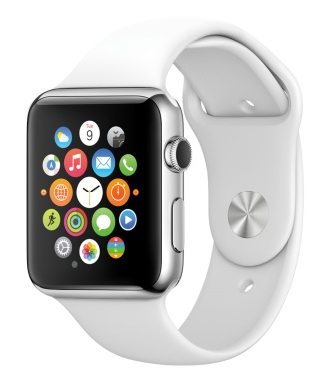
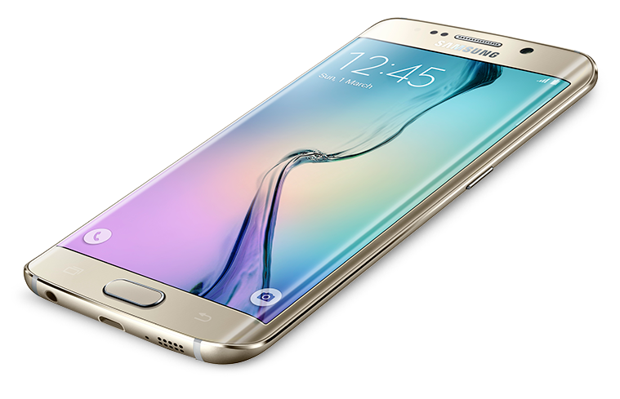
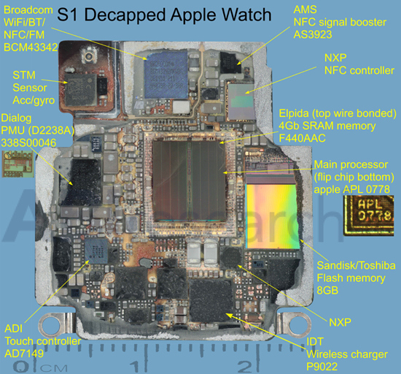
4. Capable Mobile Devices
Quad Core 1.5 GHz
128 GB Internal Memory
3 GB RAM
16 MP Camera
2160p@30fps video
WiFI, GPS, BLE

Slide 24
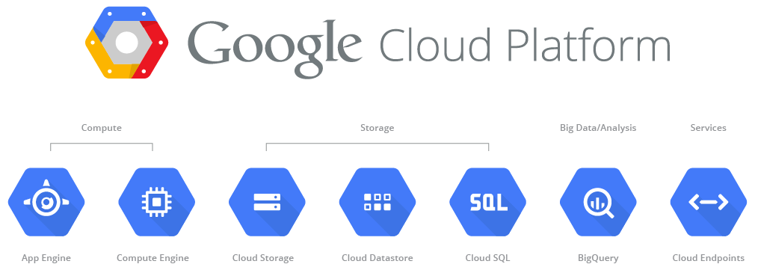
5. Power of the Cloud

Slide 25
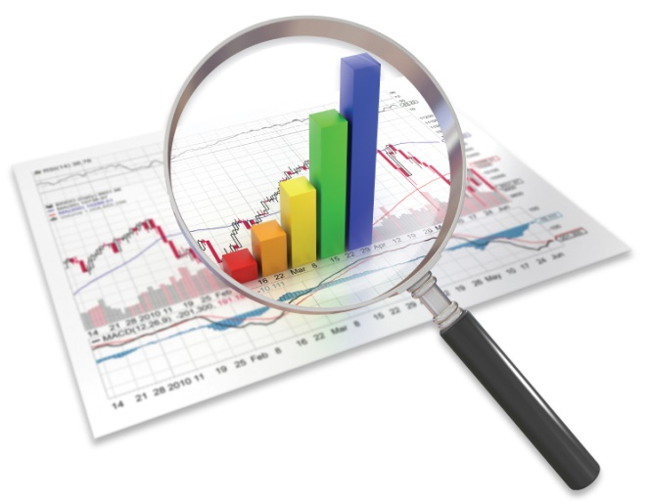
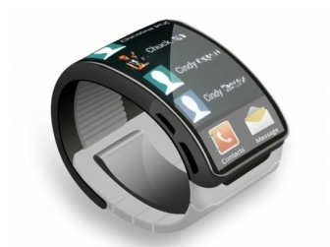
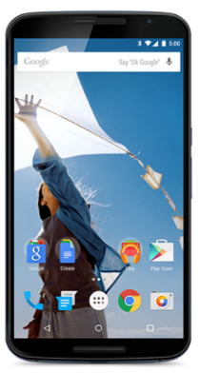
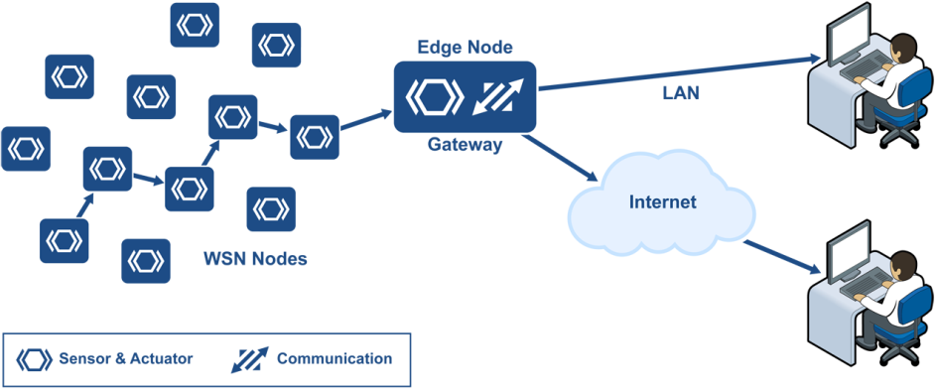
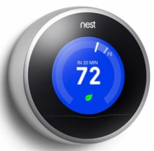
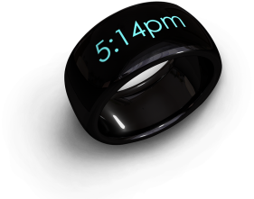
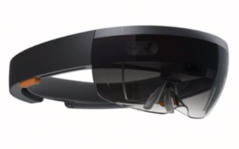
ABCD’s of IoT
Applications
Big Data Analytics
Connectivity and Communication
Devices – that are smart!
Photos – Libelium, Google Image Search

Slide 26
Applications
Ubiquitous Computing Applications
Cyber Physical Systems (CPS) Applications
Smart and Connected Health

Slide 27
Big Data Analytics
Map-Reduce
Frequent Item-sets
Similarity
Clustering
Dimension Reduction
Streaming Data

Slide 28
Connectivity
M2M
Wireless Sensor Networks
IPv6 and 6LowPAN
Bluetooth LE and ZigBee
WiFi and LTE

Slide 29
Devices and Platforms
Mobile Systems
Sensor Systems
Wearables
Energy Harvesting
Security and Privacy

Slide 30
IoT in the Research Community
Mobile Systems (MobiSys, MobiCom)
Sensor Systems (SenSys, IPSN)
Real-Time Systems (RTSS, RTAS)
Human-Computer Interaction (CHI)
Applications (UbiComp, PerCom)
ML/Data Mining (ICML, KDD)
… and more

Slide 31
#3. Paper Presentation Guidelines

Slide 32
Learn from the best
https://www.youtube.com/watch?v=2-ntLGOyHw4

Slide 33
Claim Statement: Smart and Connected Pen
Let’s try this.
A pen that _____________ is better than
_____________ in terms of _____________,
in _______________

Slide 34
COMP 790 The Internet of Things
Date: 8/20
Shahriar Nirjon
nirjon@cs.unc.edu
SN #258

Slide 35
Annonuncements
1 pg Synopsis due (everyone)
Student presentations start next week
Project selection (at least a high-level direction/idea) deadline is next week
Send me your paper numbers!

Slide 36
Agenda (8/20)
Presentation Guideline (continued)
Example: Smart Connected Pen
Synopsis Guideline
Example: Conference Review
Project Report Guideline
Handout

Slide 37
#1. Paper Presentation Guidelines (continued)

Slide 38
What do we present?
A scientific work:
Theory
Proof
A system paper:
Claims
Arguments

Slide 39
Thought Exercise
“Smart and Connected Pen” for the IoT
It’s a pen
Record (track writing) and store
Crowdsource to recognize writing
Backup notes
Emotion detection
Authentication (fingerprint)
Location, time, date
Never run out of ink
Finding is easy (RFID)

Slide 40
Forming a Well Posed Claim Statement
Simple Claim Statement:
“We propose a smart pen that authenticates the user”
A Well-posed Claim Statement:
“We propose a smart pen that authenticates the user by matching fingerprint, which 7 times faster than typing in pin numbers, in a secure writing scenario.”

Slide 41
Strong Claim Statements
Points in a well-posed claim statement:
Approach
Baseline
Metric
Context
“We propose a smart pen that authenticates the user by matching fingerprint, which 7 times faster than typing in pin numbers, in a secure writing scenario.”

Slide 42
Class Exercise (claim statements)
Let’s try some other claims.
It’s a pen
Record (track writing) and store
Crowdsource to recognize writing
Backup notes
Emotion detection
Authentication (fingerprint)
Location, time, date
Never run out of ink
Finding is easy (RFID)

Slide 43
Arguments
Arguments in support of claims
Algorithms/System Building
Experimental Evaluation
Claim #1
Arguments to support claim #1
Claim #2
Arguments to support claim #2
…….
…….

Slide 44
Elements in Arguments
Problem Statements
Algorithm Design
Experimental Design
Experimental Results:
X variables
Y variables
Baseline
Claim #1
Arguments to support claim #1
…….
Problem
Solution
Expt
Result
Problem
Solution
Expt
Result
Problem
Solution
Expt
Result

Slide 45
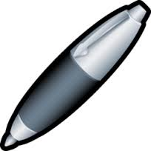
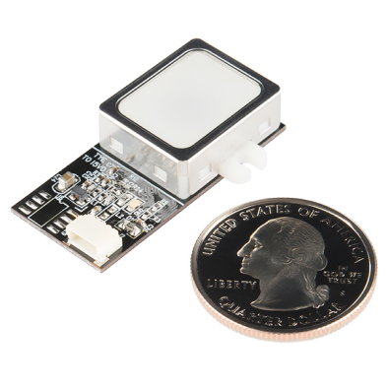
Argument: Pen Authentication
Problem: Matching fingerprint as the user holds the pen to authenticate.
System Design:
Logic to match and lock/unlock the pen…
Fingerprint Scanner - 5V TTL
(GT-511C1R)
Pen

Slide 46
Argument: Pen Authentication
Experiment Design:
3 user, store 5 samples per user
Try to authenticate 6 users (3 new users), 10 attempts for each
Experiments:
Accuracy of Authentication
Avg. time to Authenticate
User study
…

Slide 47
Argument: Pen Authentication
Results/Plots:

Slide 48
Class Exercise
Let’s try arguments for another claim
It’s a pen
Record (track writing) and store
Crowdsource to recognize writing
Backup notes
Emotion detection
Authentication (fingerprint)
Location, time, date
Never run out of ink
Finding is easy (RFID)

Slide 49
Paper Presentation
Broader Context
Claims/Problem Statements
Prior Work
Approach/Algorithms/System
Experimental Design
Results
Broader Impact

Slide 50
#2. Synopsis Guideline

Slide 51
Structure of Synopsis
Summary (claims and arguments)
Pros
Cons
Your Comments

Slide 52
#3. Project Report Guidelines (Handout)

Slide 53
Project Ideas (not limited to this)
Net: Gateway to the Internet
Net: Redesign Internet to Accommodate Things
Net: Heterogeneous Interfaces – Things don’t talk same language.
Net: App layer protocol for M2M communication.
Dev: Programming Networked Heterogeneous Systems
Data: More irrelevant data makes it harder to find a pattern.
Data: Real-Time processing of large amount of IoT data.
Data: Fast Accumulation, Steady Streams
Security and Privacy: Detection, Prevention
App: Killer App
App: IoT advertisement

